Slide 1

An augmented reality approach to promote therapy for children with ASD.
Summer 2021
499B.18 : Senior Design Project II
Group #4
Faculty Initials: SAS3
Jarin Sayma - 1711234642
S M Niaz Mahmud - 1713079042

Slide 2
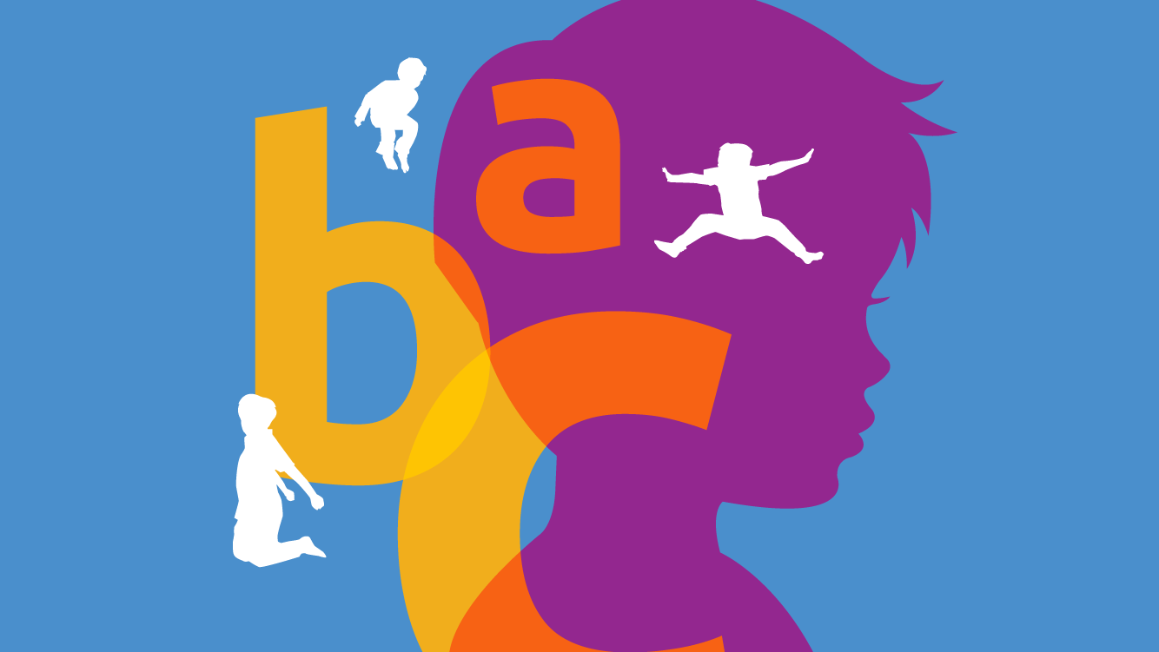
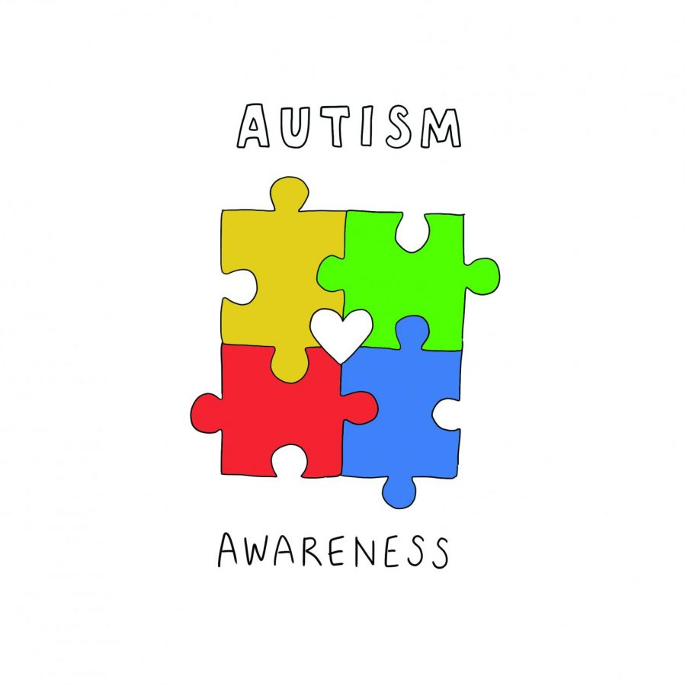
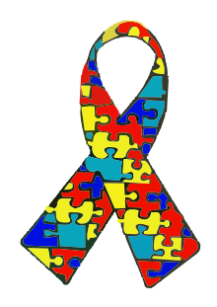
MOTIVATION

Slide 3
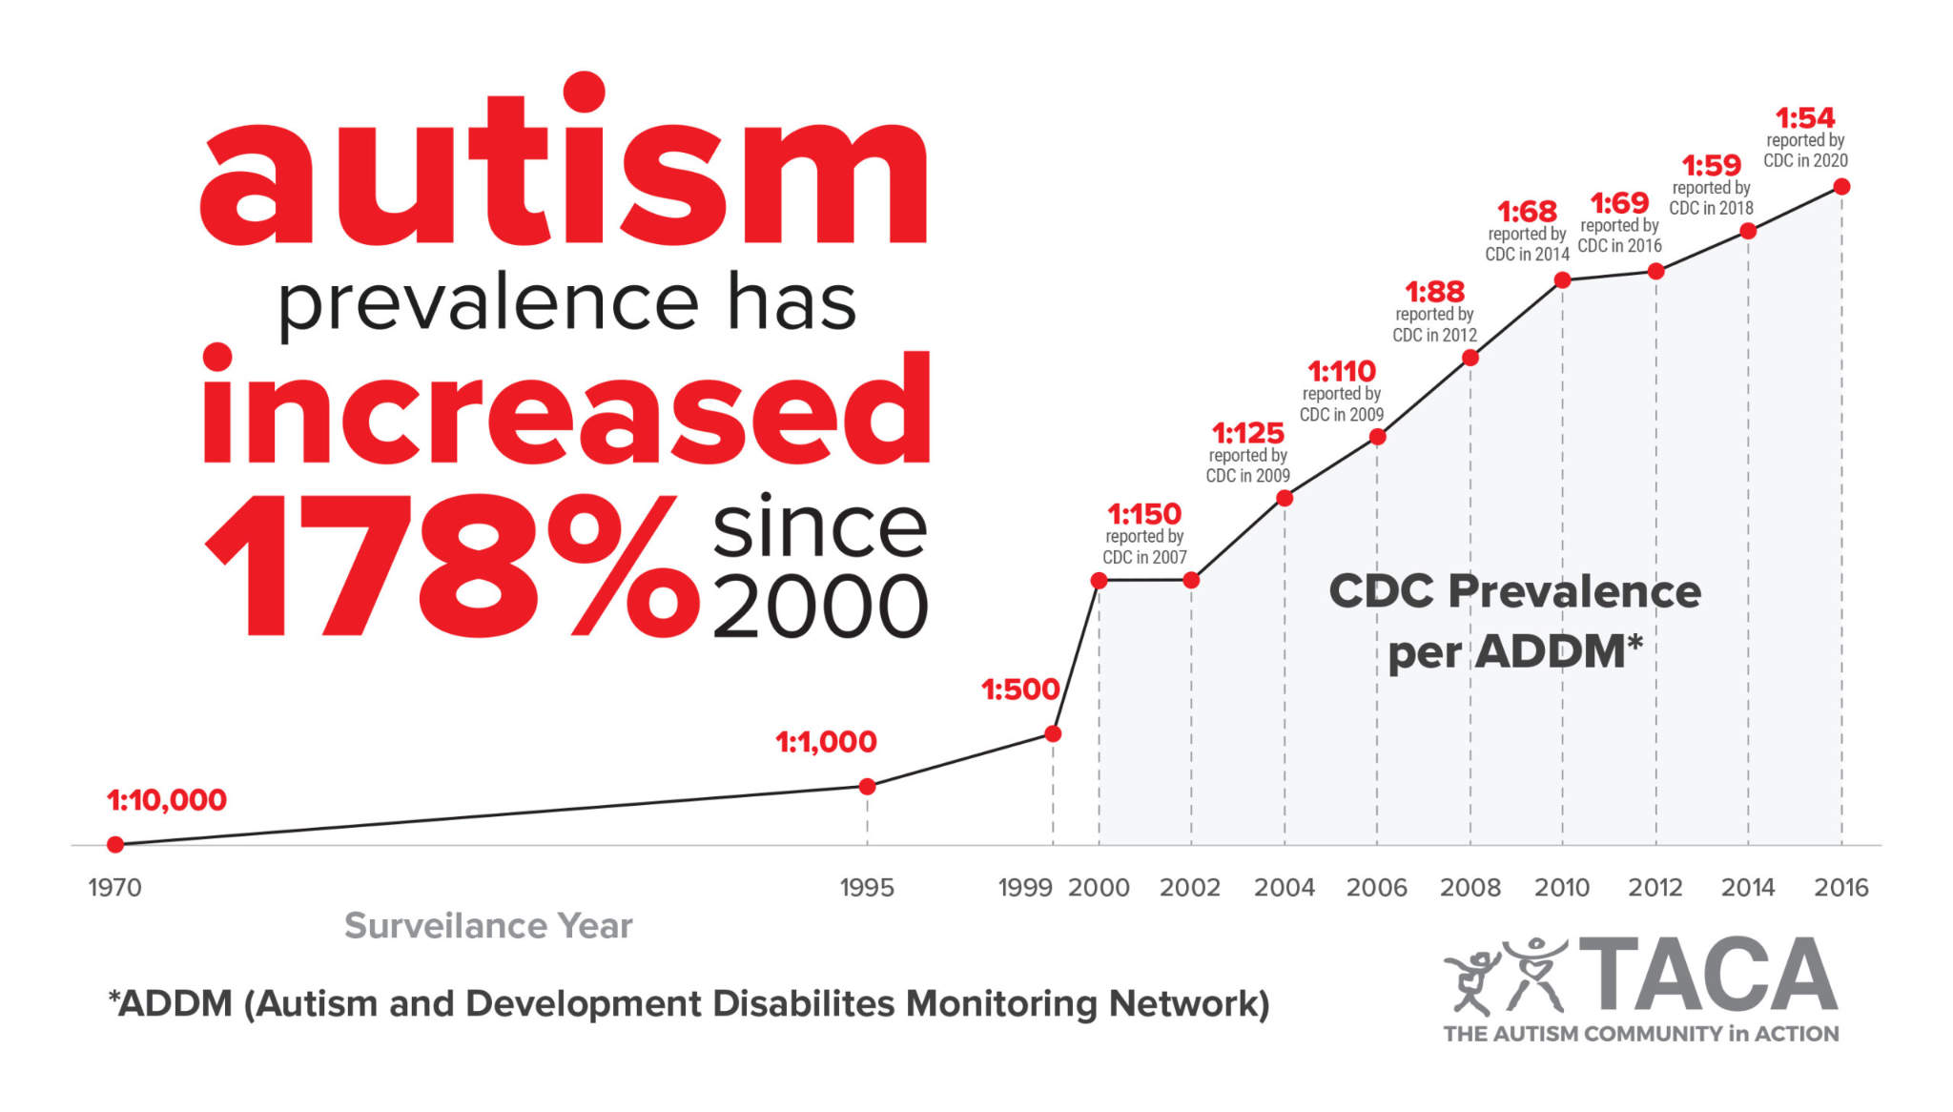
WORLDWIDE AUTISM PREVALENCE STATISTICS:
Prevalence of Autism Spectrum Disorder
Surveillance Year | Birth Year | Number of ADDM Sites Reporting | This is about 1 in X children…
2000 | 1992 | 6 | 1 in 150
2002 | 1994 | 14 | 1 in 150
2004 | 1996 | 8 | 1 in 125
2006 | 1998 | 11 | 1 in 110
2008 | 2000 | 14 | 1 in 88
2010 | 2002 | 11 | 1 in 68
2012 | 2004 | 11 | 1 in 69
2014 | 2006 | 11 | 1 in 59
2016 | 2008 | 11 | 1 in 54

Slide 4

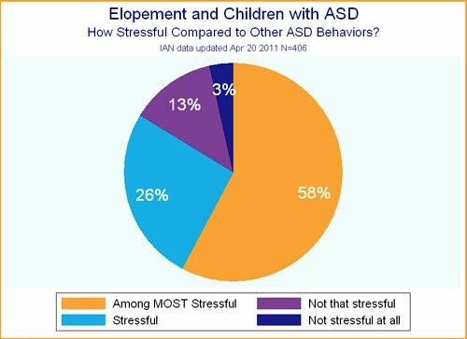
AUTISM PREVALENCE IN BANGLADESH
In 2013, Dhaka Shishu Hospital conducted a survey that reported autism prevalence to be 17 per 10,000 children aged below nine.
Prevalence of ASD was found to be ranging from 0.15–0.8% in Bangladesh.
The rural prevalence was 14 per 10,000, whereas 25 children per 10,000 were diagnosed in urban areas.

Slide 5

Identifying
Awareness
Skilled professionals
Resources
Acceptance
WHAT ARE THE BIGGEST CHALLENGES?

Slide 6
Identifying
Awareness
Skilled professionals
Resources
Acceptance
WHAT ARE THE BIGGEST CHALLENGES?

Slide 7
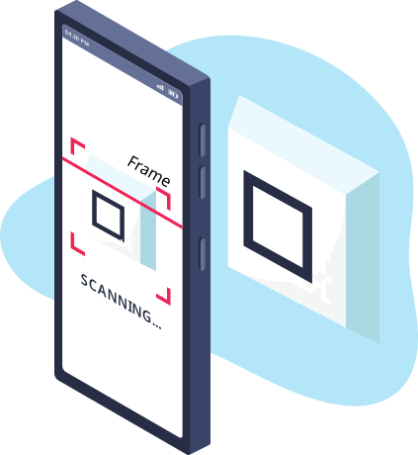

Our Aim
The aim of the project is to help children with ASD, to hear and recognize objects & environment via smartphones or tablets.
Using phone to train them
Supporting resources
Digitalize learning

Slide 8
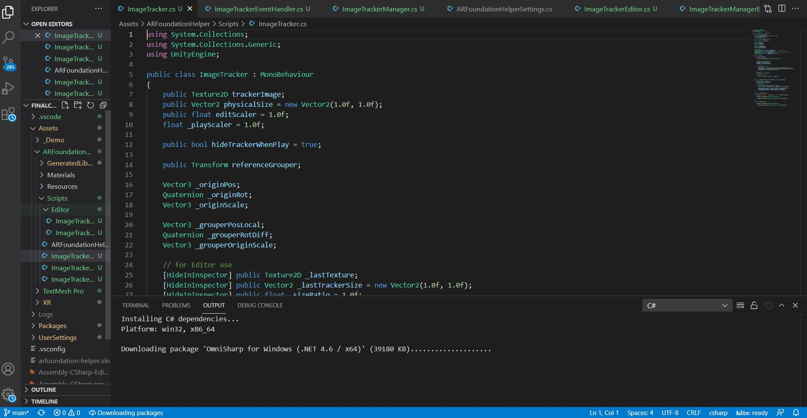
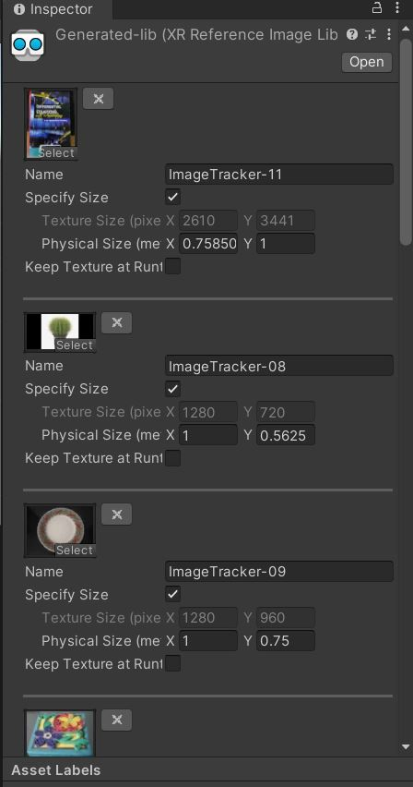
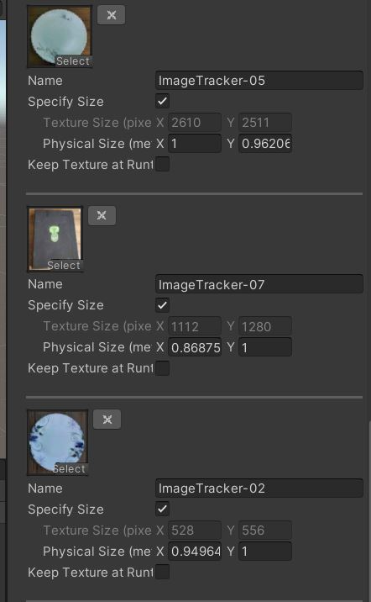
How the App works
create a gameobject in unity
integrate the image tracking script
update the database from image tracking manager
generate the app for android/ios

Slide 9

Demo
A short video has taken from both of our houses separately.

Slide 10
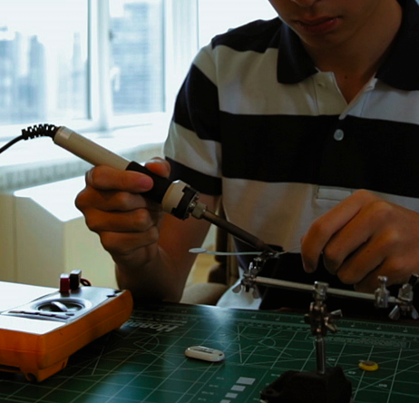
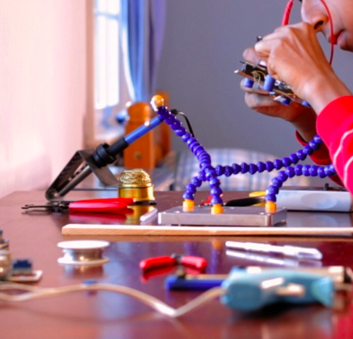

Findings
Version of unity
High resolution pictures.
AR supported phone.
Fine 3d modelling.
Real time scanning.

Slide 11
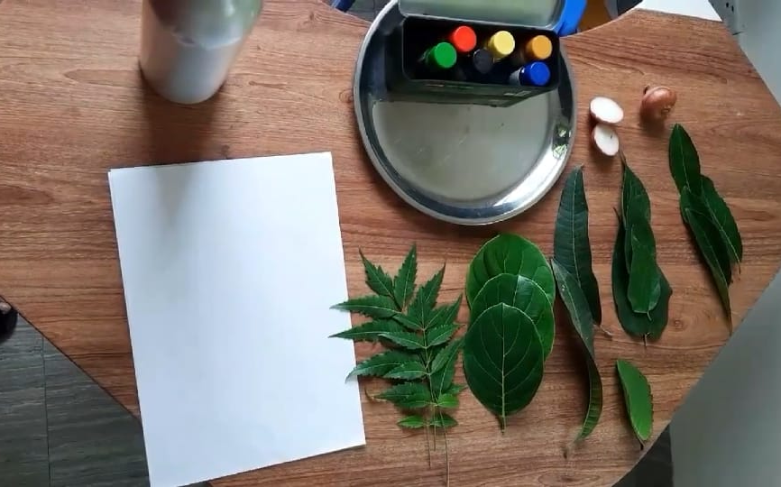
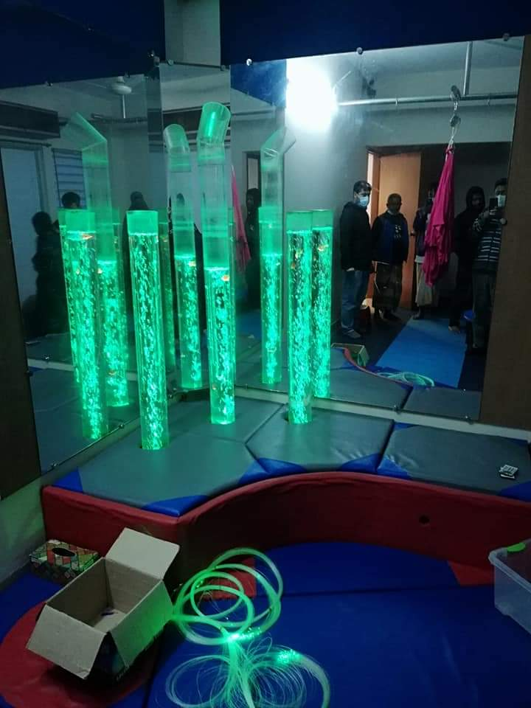
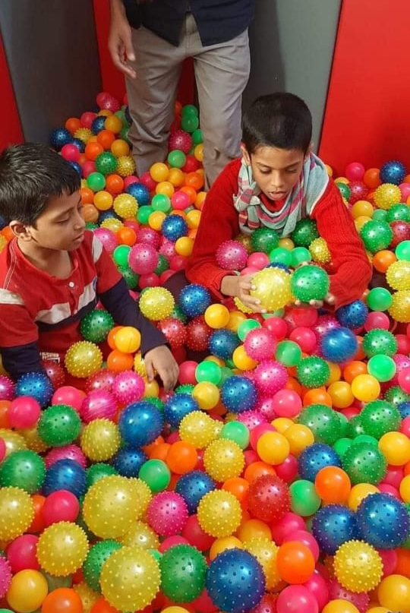
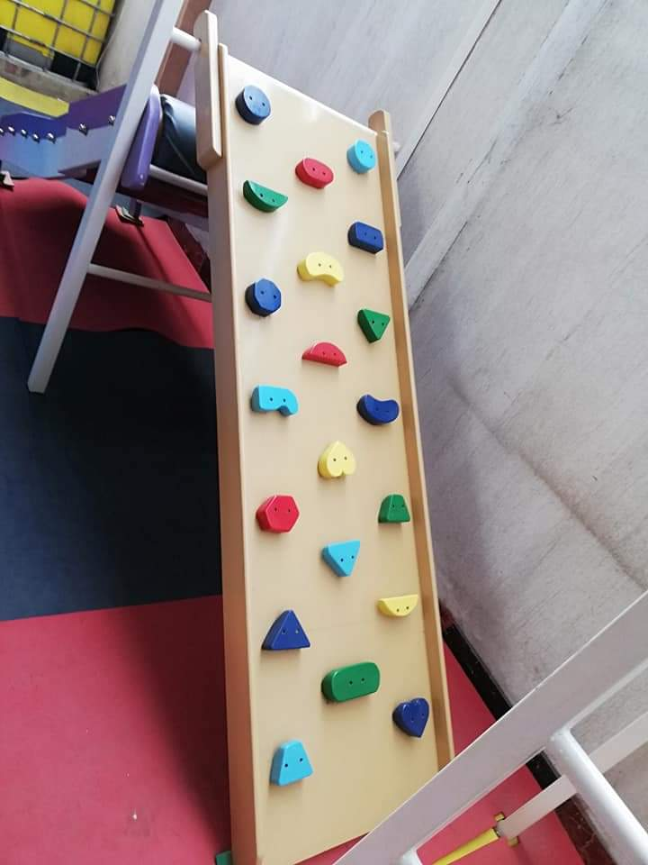
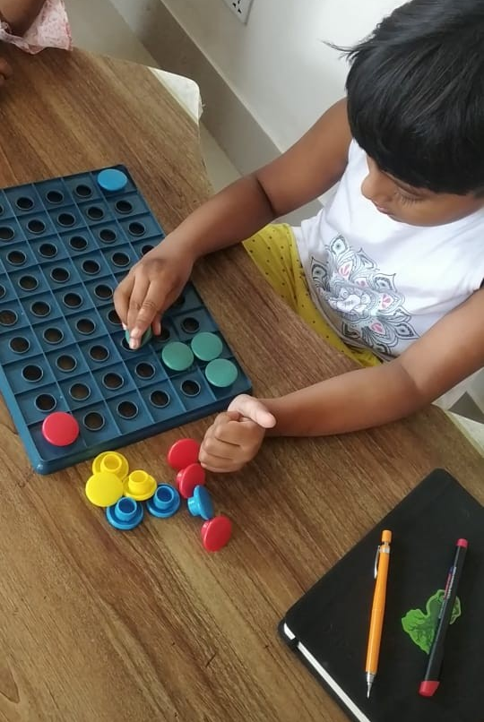
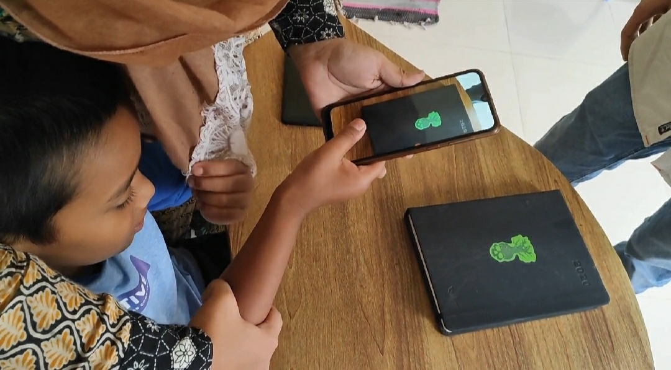

Slide 12

Can Autism be Cured?

Slide 13
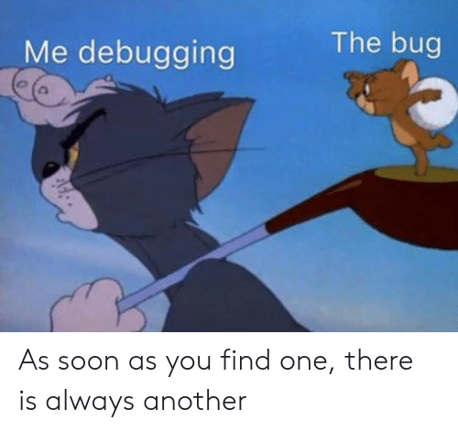
Bug we faced:
Development:
Unity
Database
Image Tracking
Device
Implementation:
Age
Stage
Training
Acceptance

Slide 14

Future Plans
Improving existing App
Use AR or VR for therapies
Tutorials for both trainer and parents.
An app for recognizing dangers
App based task

